Slide 1


A Matrix-free Algorithm for Reduced-space PDE-governed Optimization
Pengfei Meng

Slide 2
Outline
Introduction
Homotopy-Based Globalization
Matrix-free Preconditioner
Tests and Applications
Contributions and Recommendations

Slide 3
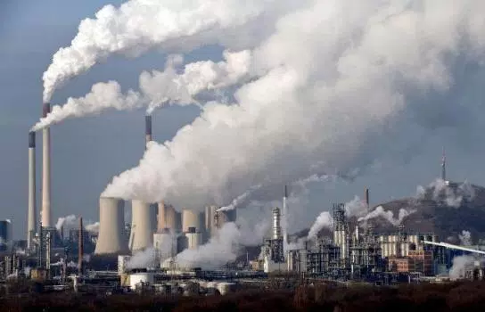
Improved engineering design is needed to address climate change
Introduction  Optimization  Preconditioner  Tests  Summary
Notes:
https://www.mercurynews.com/2017/04/24/extreme-weather-linked-to-greenhouse-gases-stanford-study-says/

Slide 4
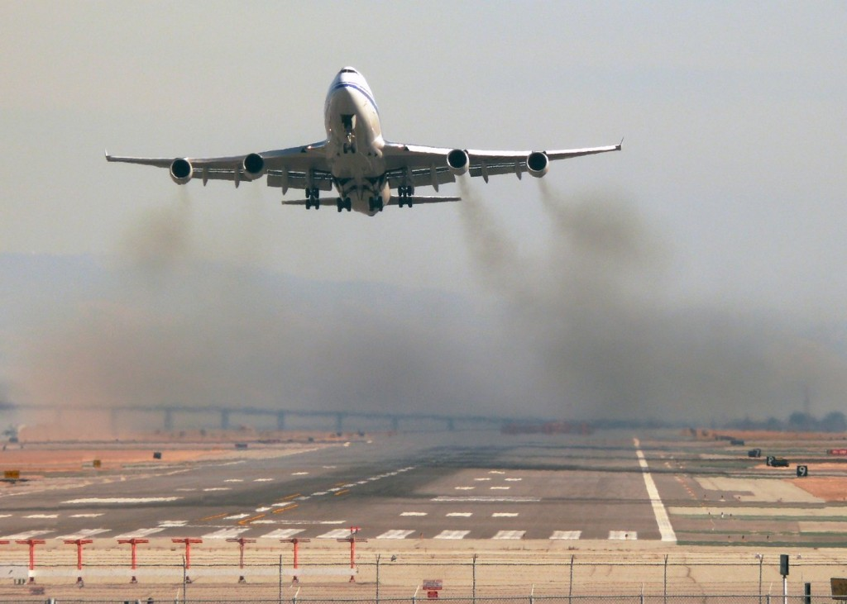
Aviation can reduce its emissions by improving aircraft through optimization
Introduction  Optimization  Preconditioner  Tests  Summary

Slide 5
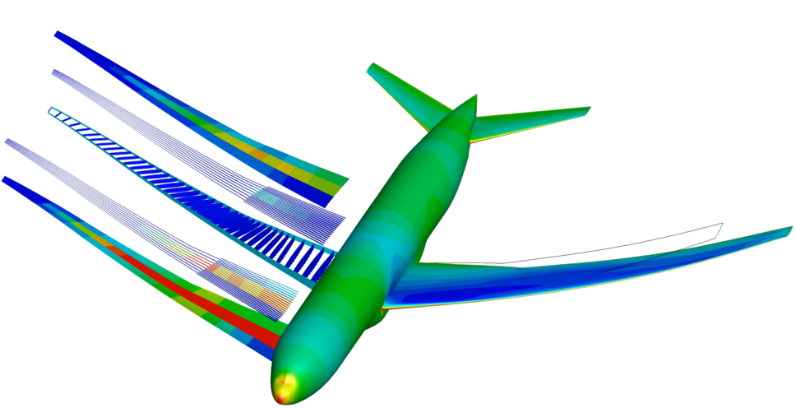
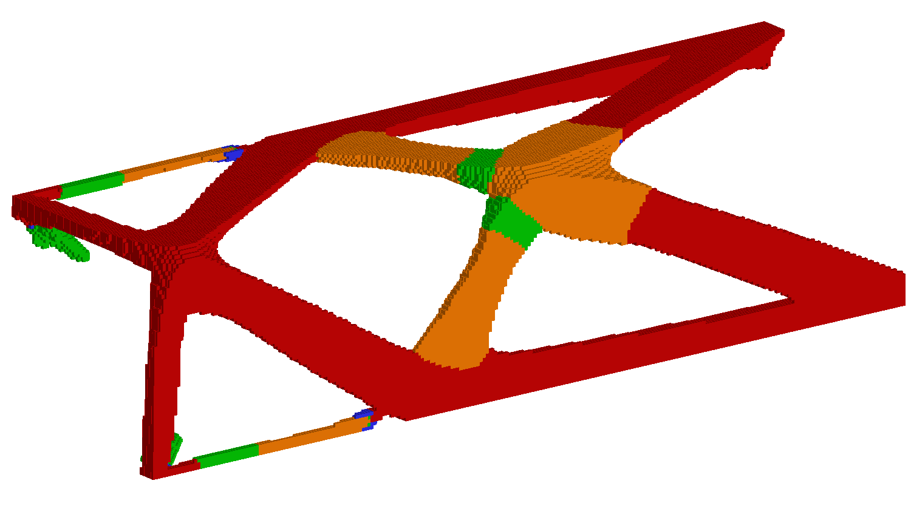
Optimization problems with state-based constraints are common, yet challenging to solve
Aero-Structural Optimization
Kenway and Martins [16]
Topology Optimization
Kennedy [17]
Introduction  Optimization  Preconditioner  Tests  Summary
Notes:
PDE solution is a subproblem associated with optimization, major cost; solving the PDE equation, adjoint equation is the most expensive part;
Size is very large, as the state and adjoint solve size mesh-dependent ; large-scale
discretized Euler equation

Slide 6
Conventional optimization algorithms are poorly suited for state-based constraints
Conventional (matrix-based) optimization algorithms require the explicit total constraint Jacobian
The gradient of each constraint requires the solution of a linear PDE (the adjoint)
Cost is intractable when there are hundreds of constraints
Storing the (dense) constraint Jacobian can also be expensive
Introduction  Optimization  Preconditioner  Tests  Summary
Notes:
Conventional optimization algorithms have been used on PDE-governed optimization problems
When there are relatively few state-based constraints, SNOPT, IPOPT, Knitro

Slide 7
We will consider the following, generic PDE-constrained optimization problem
The Lagrangian:
Introduction  Optimization  Preconditioner  Tests  Summary
Notes:
Be sure to give the audience concrete examples of each of these functions. You can do this using either text or orally.
For example, f can be drag or weight, or range. h might be a lift constraint. g might be stress or bound constraints, etc.
S: is for slack variables ; x, u

Slide 8
Optimal designs satisfy the first-order optimality conditions (KKT condition)
Adjoint Equation:
State Equation:
Complementarity:
A coupled, nonlinear system of equations
ill-conditioned
potentially large
Introduction  Optimization  Preconditioner  Tests  Summary
Notes:
Complementarity e:

Slide 9
The full-space approach solves all the variables simultaneously, including the PDE state and adjoint
The full-space KKT-system is large (at least 2 times the number of states), indefinite, and ill-conditioned
Globalization algorithms for nonlinear PDEs are difficult to incorporate into full-space methods
If the full-space optimization does not converge, the PDE is not even satisfied and cannot be used to inform decision making
Introduction  Optimization  Preconditioner  Tests  Summary
Notes:
In optimization iteration, the state and adjoint solve do not converge tightly.

Slide 10
The reduced-space approach treats the PDE state and adjoint as implicit functions
Reduced-space methods can make use of existing simulation solvers and adjoint solvers
The reduced-space optimization system is much smaller than the full-space system
Reduced-space algorithms have been successfully applied to unconstrained and equality-constrained problems
Introduction  Optimization  Preconditioner  Tests  Summary

Slide 11
An advantage of the reduced-space approach is its modular structure
Initial Design, x₀
Final Design, x*
Yes
Optimization Algorithm
Converged?
Solve Adjoint(s)
No
No
Yes
Gradient(s) ?
Solve PDE
Mesh Movement
Introduction  Optimization  Preconditioner  Tests  Summary
Notes:
Optimality and feasibility

Slide 12
The reduced-space KKT conditions are as follows:
Introduction  Optimization  Preconditioner  Tests  Summary
Notes:
Note that the dependence on the state and adjoint vector has been omitted, as for each new x, state and adjoint are updated implicitly;

Slide 13
Inexact-Newton methods are attractive for solving the reduced-space problem
We solve the root-finding problem using a Newton-based approach
The KKT-vector products are evaluated matrix-freely using second-order adjoints
This way the explicit Hessian and the explicit total constraint Jacobian are not required
The cost of the KKT-vector products is virtually independent of the number of design variables and nonlinear constraints
Introduction  Optimization  Preconditioner  Tests  Summary

Slide 14
The following challenges must be addressed in order to use inexact-Newton methods for general nonlinear constraints
Globalization: must avoid stationary points that are not local minimizers, i.e. handle nonconvexity.
Preconditioning: accelerate the convergence of Krylov iterative methods in a matrix-free way.
Introduction  Optimization  Preconditioner  Tests  Summary

Slide 15
Outline
Introduction
Homotopy-Based Globalization
Matrix-free Preconditioner
Tests and Applications
Contributions and Recommendations

Slide 16
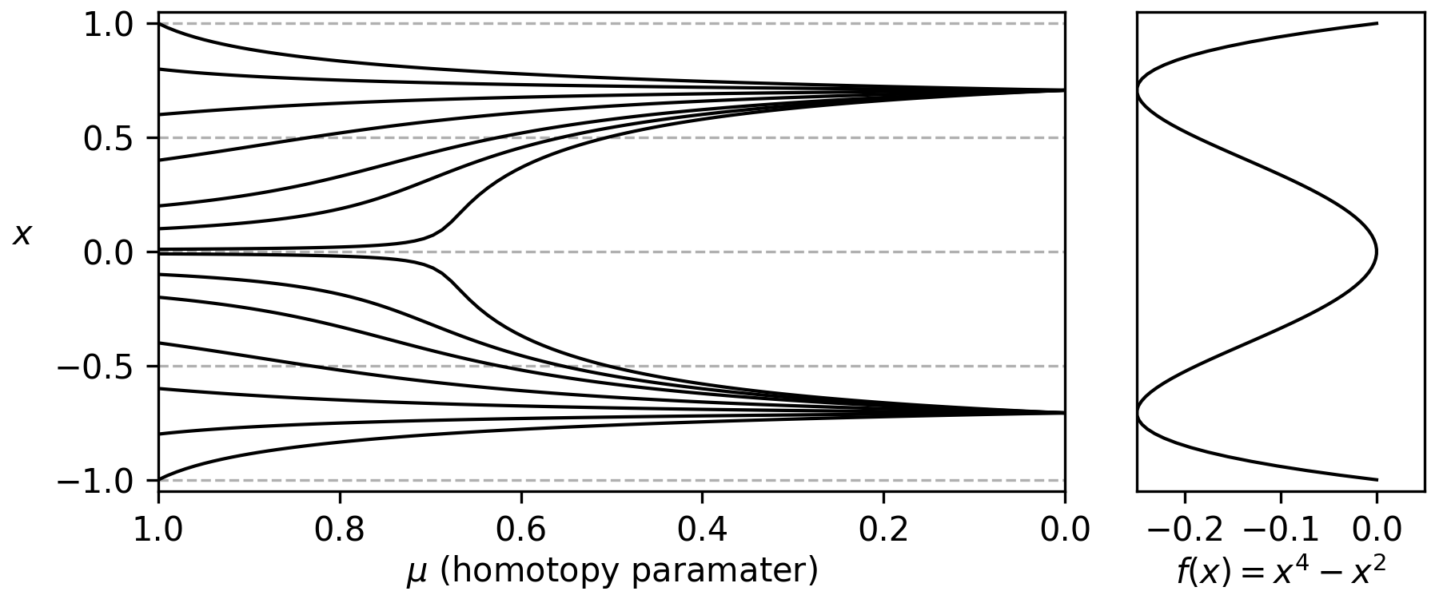
A homotopy map defines a solution path from an easy-to-obtain solution to the desired solution
The desired problem:
The easy problem:
Introduction  Optimization  Preconditioner  Tests  Summary
Notes:
The solution trajectory, the path of x, goes from the zero of the simple function to the zero of the original function;
Each curve represents a solution trajectory for different value of a;
For this simple problem, the method is globally convergent, as different a, or different starting point, all lead to the same solution

Slide 17
For constrained optimization we use the following convex homotopy
The Jacobian of the Homotopy function is
Introduction  Optimization  Preconditioner  Tests  Summary

Slide 18
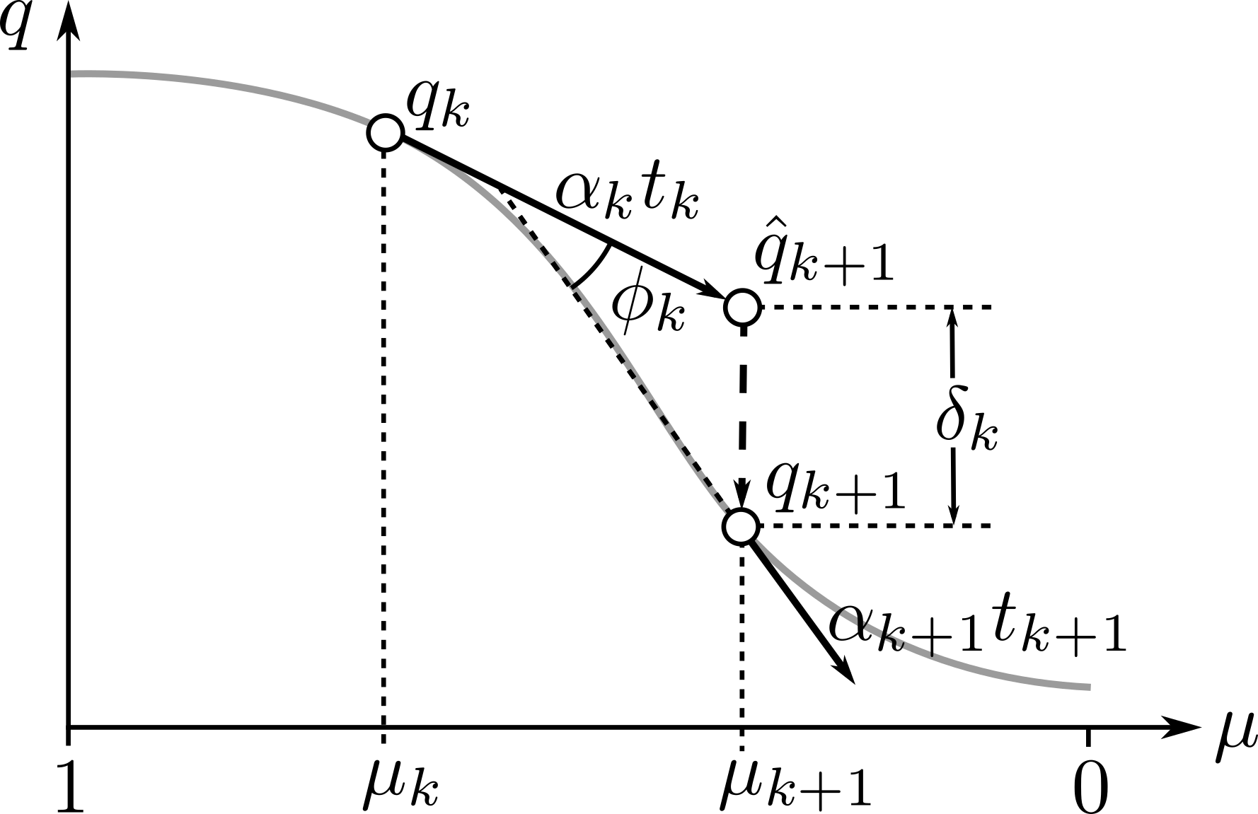
A predictor-corrector algorithm is used to trace the homotopy zero-curve
In predictor step:
In corrector step:
Introduction  Optimization  Preconditioner  Tests  Summary
Notes:
It will be easier to describe the algorithm first without mentioning inexact solves.

Slide 19
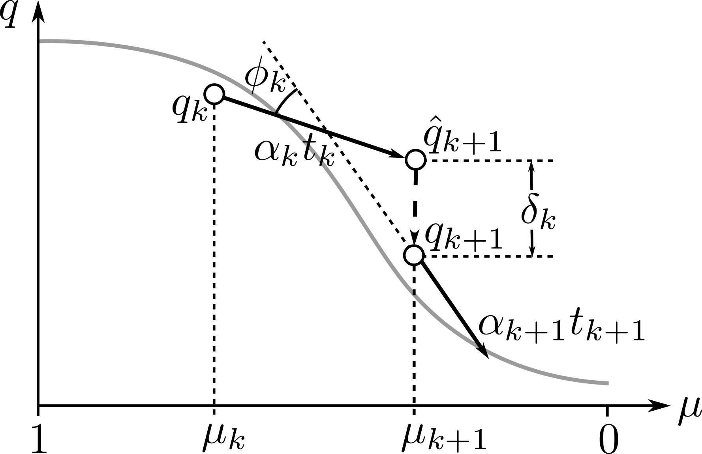
In practice, the predictor and corrector steps use inexact solves
In predictor step:
In corrector step:
Introduction  Optimization  Preconditioner  Tests  Summary
Notes:
Be sure to explain orally that this grey curve is the zero contour of H, and that it gives the desired solution when \mu= 0.
Methods for tracing the solution curve of the homotopy; one type of predictor-corrector algorithm;
Calculate the tangential direction of the solution curve for updating q and mu; then mu is fixed, Newton-Krylov method to bring the predictor point closer to the solution curve;
go back two slides and explain that this is how the red lines on slide 8 are created.

Slide 20
The tangent linear problem in the predictor step involves several steps:
1. Inexact Krylov solve:
2. The tangent direction is obtained from
3. The predictor point is calculated as follows:
Introduction  Optimization  Preconditioner  Tests  Summary

Slide 21
The step-size is controlled adaptively to help keep the predictor close to the zero curve
Initial parameters:
Step-size factor:
Step-size:
Introduction  Optimization  Preconditioner  Tests  Summary

Slide 22
The slack variables and inequality multipliers must be safeguarded
Slack Variable
Inequality Multipliers
Introduction  Optimization  Preconditioner  Tests  Summary

Slide 23
Globalization Experiment 1: Sphere Problem
Problem Formulation:
True Solution:
Local Maximizer:
Introduction  Optimization  Preconditioner  Tests  Summary
Notes:
At the beginning of the solution path, when mu equals 1, the simple KKT system is at play;
At the end of the solution path, when mu equals 0, the true KKT system is in effect. In the middle, it’s a mixture of the two.
The simple KKT system has nice properties: the reduced Hessian is positive definite, and the calculated design update would be a feasible descent direction.
The added homotopy term functions as regularization and globalization unit;
When the true KKT system has nonconvex Hessian, the added regularization from the simple KKT helps the trajectory enter the neighborhood of the local minimum for the original problem; help bypass the local maximum stationery point;
Newton method behave poorly around stationery point, indefinite matrix

Slide 24
Globalization Experiment 1: Sphere Problem
The initial guesses were generated by adding Gaussian perturbations, , to each coordinate of
Introduction  Optimization  Preconditioner  Tests  Summary

Slide 25
Globalization Experiment 1: Sphere Problem
As a second test, the initial guesses were generated by standard normal distribution around the origin
Introduction  Optimization  Preconditioner  Tests  Summary

Slide 26
Globalization Experiment 2: Non-convex Problem
Problem Formulation:
The pattern of the Hessian matrix and the initial point
are both randomly generated
Q_{i} = 1
-1
0
1
-1
0
1
Q_{i} = -1
Introduction  Optimization  Preconditioner  Tests  Summary

Slide 27
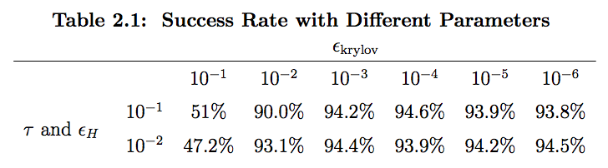
Globalization Experiment 2: Non-convex Problem
Introduction  Optimization  Preconditioner  Tests  Summary

Slide 28
Globalization Experiment 2: Non-convex Problem
The optimization criteria are described later
Introduction  Optimization  Preconditioner  Tests  Summary

Slide 29
Outline
Introduction
Homotopy-Based Globalization
Matrix-free Preconditioner
Tests and Applications
Contributions and Recommendations

Slide 30
The most expensive part of the matrix-free algorithm is inexactly solving the linear systems
Predictor Step
Newton Step in Corrector
The linear systems that arise are solved inexactly using Flexible GMRES
Introduction  Optimization  Preconditioner  Tests  Summary
Notes:
Mention orally that you will describe the approach to solving these linear systems in the next section of the presentation.

Slide 31
The reduced-space KKT system must be preconditioned
The true KKT system in optimization is ill-conditioned, FGMRES will stall without an effective preconditioner.
A preconditioner transforms the linear system to a better conditioned one with the same solution:
General preconditioners based on an explicit matrix are not applicable, e.g. ILU factorizations.
Introduction  Optimization  Preconditioner  Tests  Summary

Slide 32
The preconditioner is trying to approximately solve the following system

Slide 33
For inequality-only constrained problems, the matrix-free preconditioner involves three steps
Step 1: elimination of the slack and multiplier terms
using the Schur complement
Introduction  Optimization  Preconditioner  Tests  Summary
Notes:
Be sure to explain orally the challenges associated with inverting C_\mu.

Slide 34
For inequality-only constrained problems, the matrix-free preconditioner involves three steps
Step 2: Use a Lanczos SVD approximation for the constraint Jacobian terms
Step 3: Apply the Sherman-Morrison formula to obtain the desired design update
Introduction  Optimization  Preconditioner  Tests  Summary
Notes:
Be sure to explain orally that the Lanczos method only requires matrix-vector product, and that these matrix-vector products are approximated inexpensively by using the PDE preconditioner in place of a full PDE solve.
Orally, explain what A and UV are in the context of the above matrices.

Slide 35
When equality constraints are included, the Schur complement is augmented
To solve this, is kept away from zero in the preconditioner using the clipping rule ; consequently, the system can be solved approximated as follows.
The Lanczos SVD approximation is applied to the sum of the equality and inequality Jacobian terms
Introduction  Optimization  Preconditioner  Tests  Summary
Notes:
This way, the augmented Schur complement is calculated matrix-freely, and the slack and inequality multipliers can be retrieved as before.

Slide 36
The algorithms have been implemented in a Python library[44]
Algorithms have been implemented in Kona, a matrix-free optimization package for PDE-constrained problems
Kona uses the following convergence metrics:
For benchmarking, we compare against SNOPT, which is a state-of-the-art active-set algorithm frequently used in the engineering optimization community
Introduction  Optimization  Preconditioner  Tests  Summary

Slide 37
Preconditioner Experiment: Scalable Quadratic Problem
Problem Formulation:
The singular values of and are predefined:
Randomly generated orthonormal matrix
Introduction  Optimization  Preconditioner  Tests  Summary
Notes:
Dimension of the problem n : 100, 200, 300, 400, 500
Q and A are full rank matrices, condition number unchanged when dimension increases
condition number unchanged when dimension increases
be sure to explain why you are considering this problem.

Slide 38
This simple example illustrates the effectiveness of the preconditioner
200 design variables
Introduction  Optimization  Preconditioner  Tests  Summary

Slide 39
This simple example illustrates the effectiveness of the preconditioner
500 design variables
Introduction  Optimization  Preconditioner  Tests  Summary

Slide 40
The proposed preconditioner helps the inexact-Newton algorithm scale well with problem size; second
(seconds)
Introduction  Optimization  Preconditioner  Tests  Summary

Slide 41
Outline
Introduction
Homotopy-Based Globalization
Iterative Solver & Preconditioner
Tests and Applications
Contributions and Recommendations

Slide 42
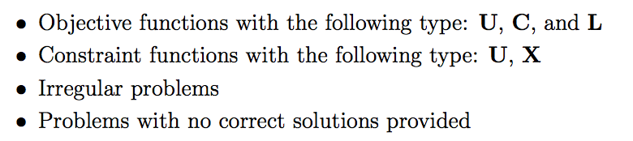
The algorithms were verified on a subset of the CUTEr test suite, a collection of test problems for optimization algorithms
The following types of problems are excluded:
A summary of Table 4.1, which contains the test results of a subset of the CUTEr problems:
Overall 63 problems are tested
Kona accurate: 60
SNOPT accurate: 39
Introduction  Optimization  Preconditioner  Tests  Summary
Notes:
What cuter is??

Slide 43
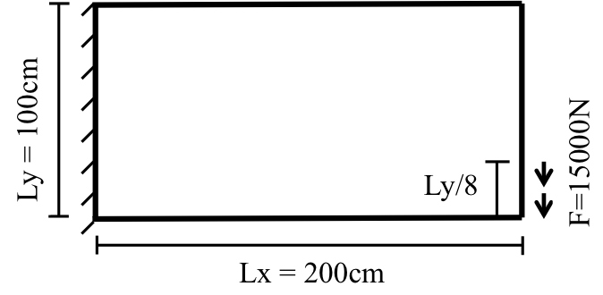
PDE-governed problem 1: Stress-Constrained Mass Minimization
The governing PDE models the response of the plate to the applied force using linear elasticity with 2D plane stress
Introduction  Optimization  Preconditioner  Tests  Summary
Notes:
X: thickness of each element
F: structural constitutive equation between thickness distribution x and displacements

Slide 44
The preconditioner is required to ensure convergence of the Krylov iterative method
Krylov-solver convergence history corresponding to the first Newton for the first Newton step at the final corrector phase for the small case
Introduction  Optimization  Preconditioner  Tests  Summary

Slide 45
The proposed algorithm is able to converge the problem on all three grids
Small
Introduction  Optimization  Preconditioner  Tests  Summary

Slide 46
The proposed algorithm is able to converge the problem on all three grids
Medium
Introduction  Optimization  Preconditioner  Tests  Summary
Notes:
SVD preconditioner is effective helping with convergence
The increasing cost with scaling is driven by increasing SVD ranks
SNOPT has difficulty locating active constraints

Slide 47
The proposed algorithm is able to converge the problem on all three grids
Large
Introduction  Optimization  Preconditioner  Tests  Summary

Slide 48
The thickness distribution obtained using the three methods is slightly different
New method with preconditioner
SNOPT
New method without preconditioner

Slide 49
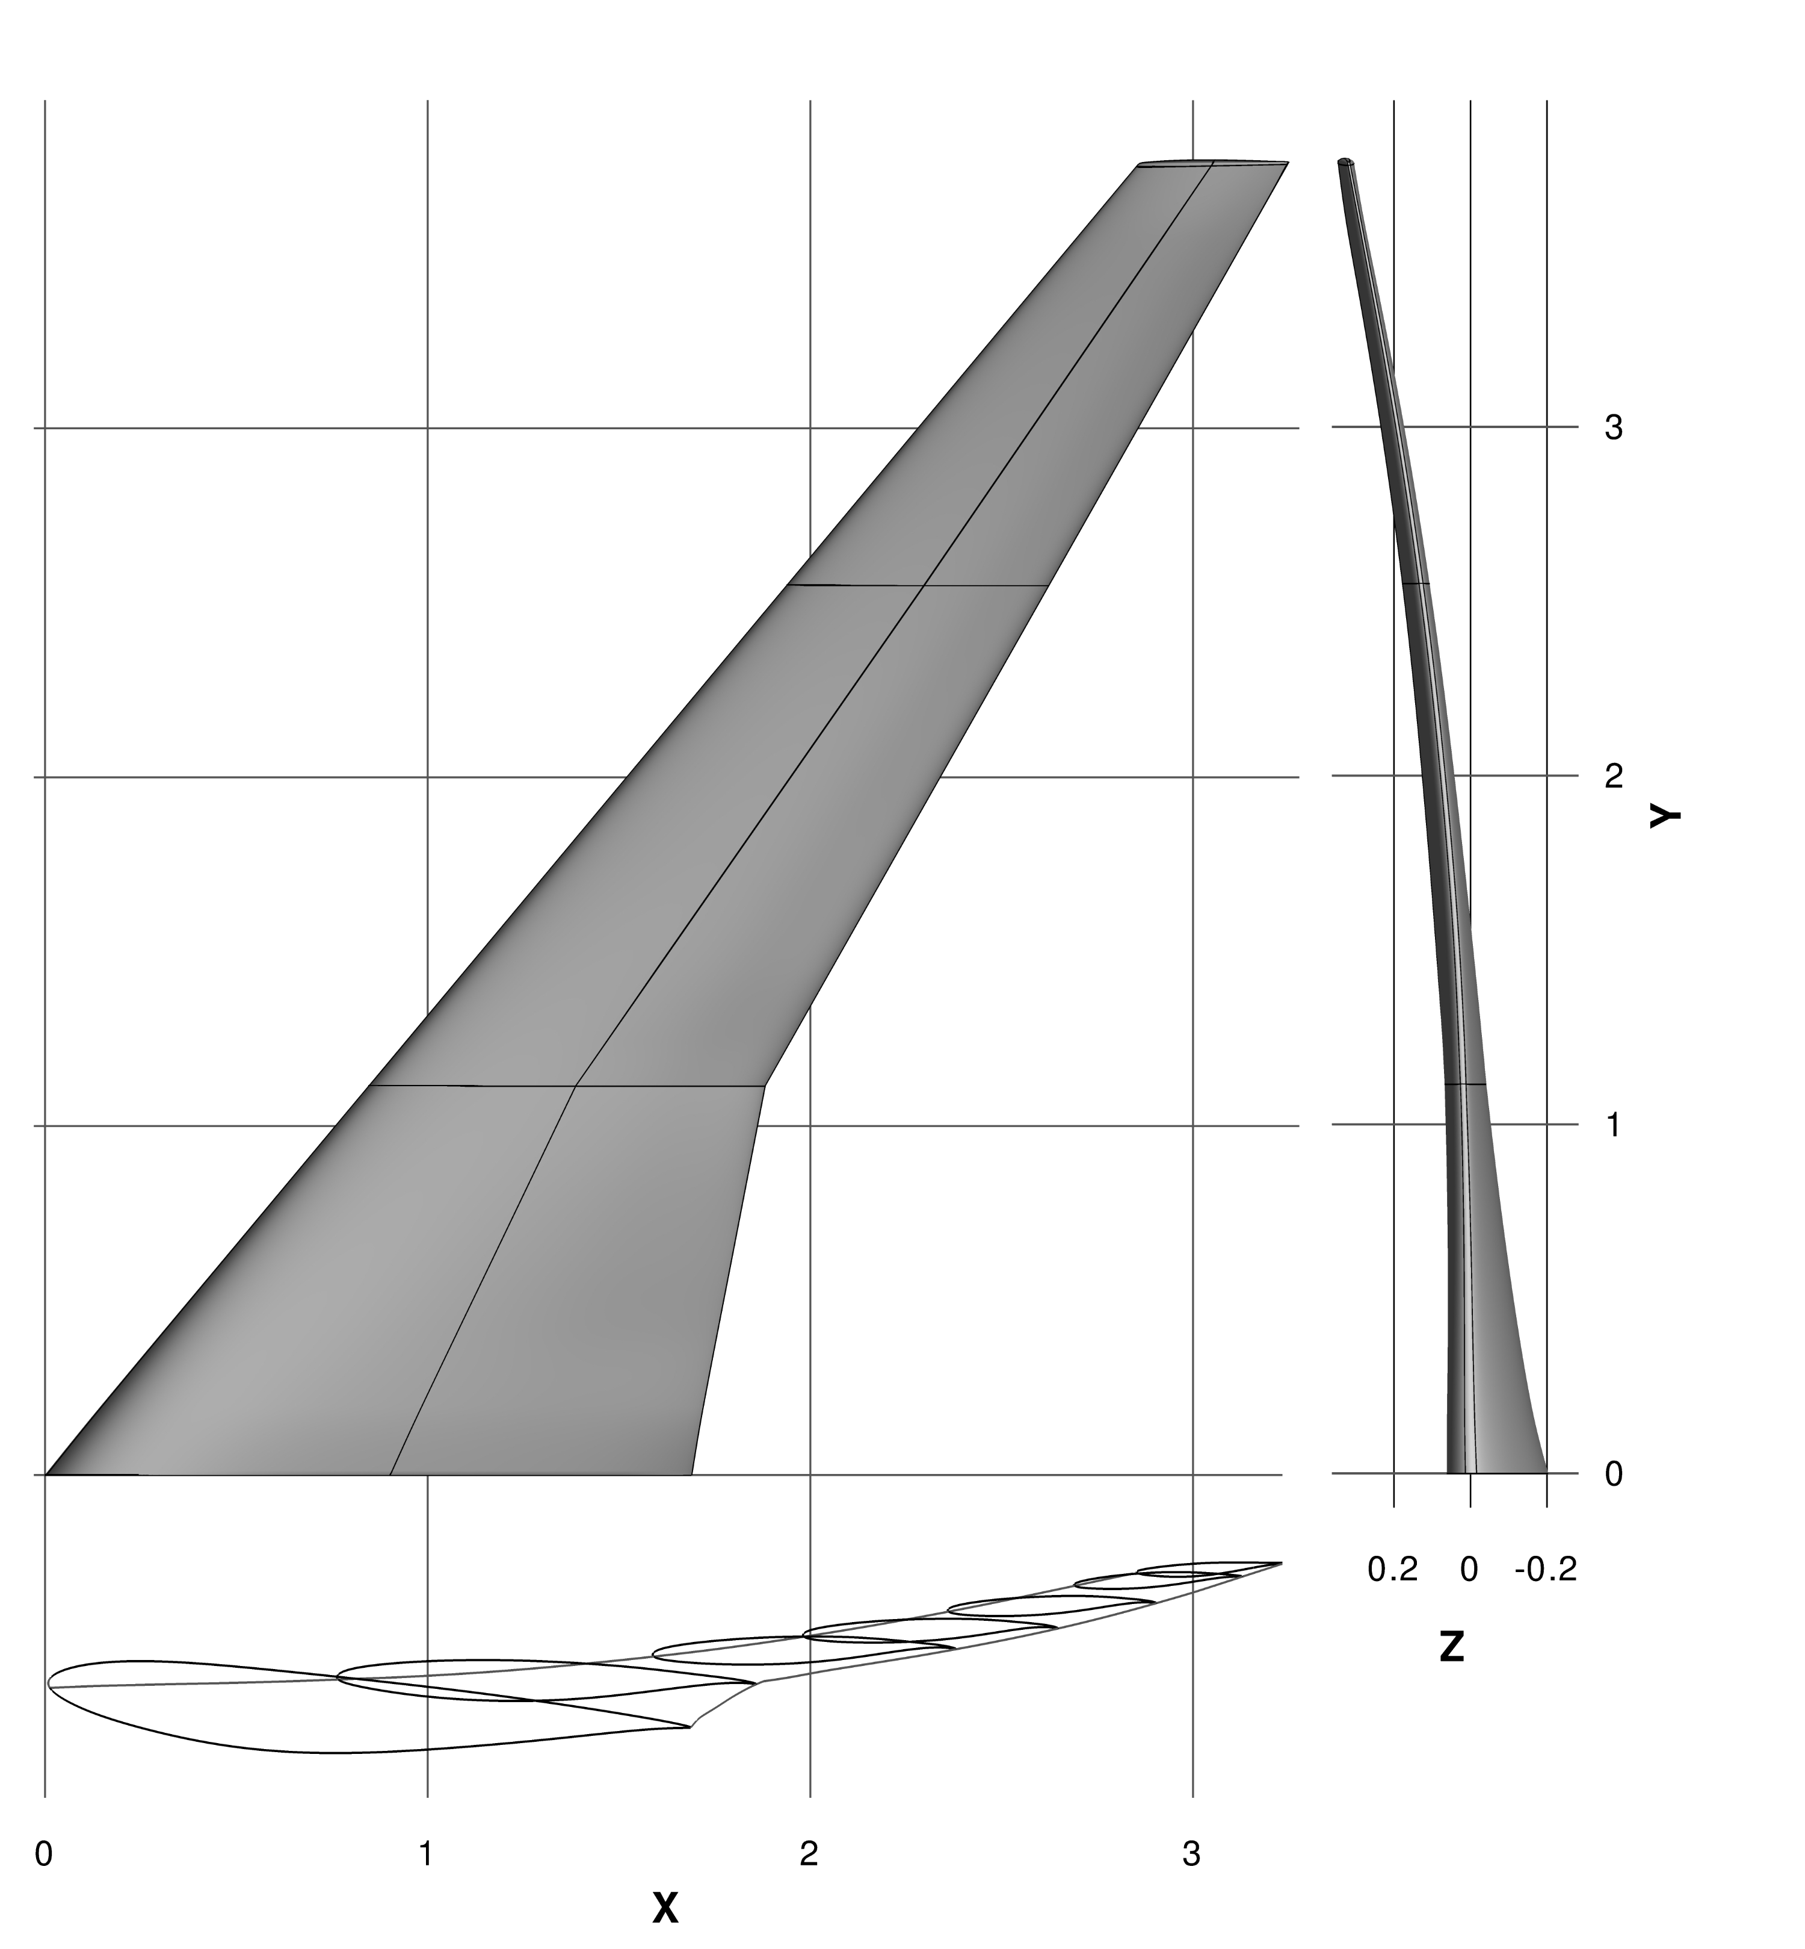
PDE-governed problem 2: Aerodynamic Shape Optimization Problem
NASA Common Research Model (CRM) wing defined by AIAA/ADODG
Introduction  Optimization  Preconditioner  Tests  Summary

Slide 50
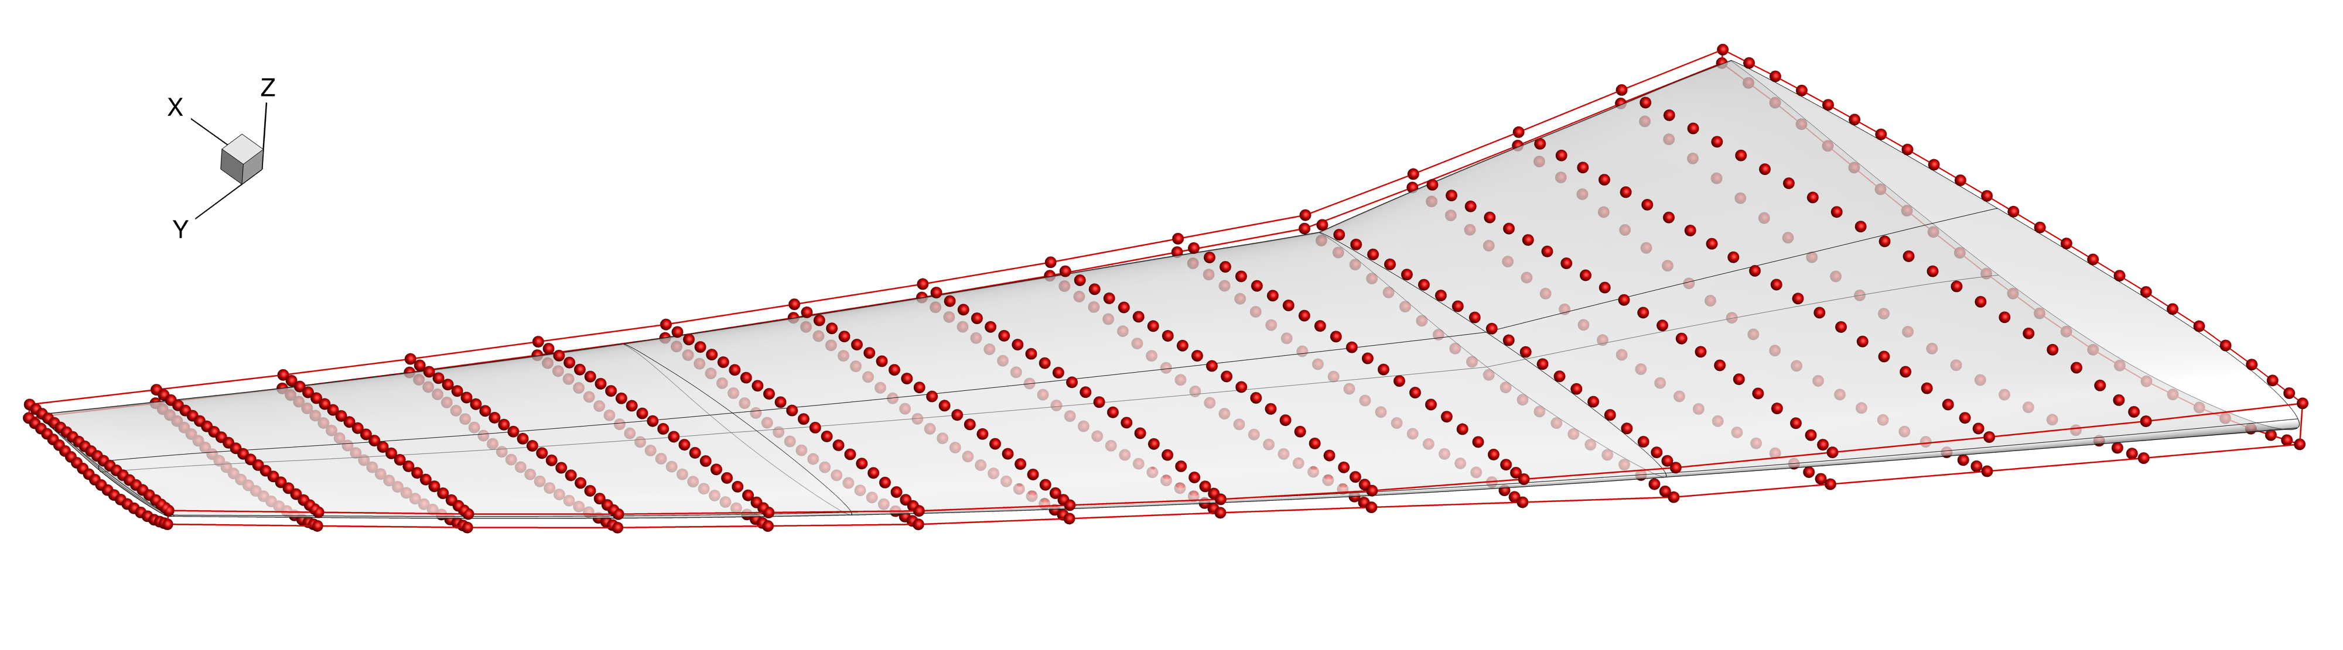
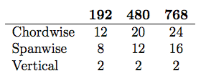
Free-form deformation is used to parameterize the wing shape [ Adflow / FFD ]
Three different sized FFD control volumes were considered
Introduction  Optimization  Preconditioner  Tests  Summary

Slide 51
Aerodynamic coefficient history and optimization plots from Kona
Number of Design: 768
Introduction  Optimization  Preconditioner  Tests  Summary

Slide 52
Aerodynamic coefficient history and optimization plots from SNOPT
Number of Design: 768
Introduction  Optimization  Preconditioner  Tests  Summary

Slide 53
Outline
Introduction
Homotopy-Based Globalization
Iterative Solver & Preconditioner
Tests and Applications
Contributions and Recommendations

Slide 54
Contributions
Developed a reduced-space Newton-Krylov method for general constrained PDE-governed design problems
Used a Homotopy-based method to increase the reduced-space inexact-Newton method’s globalization capacity
Created a novel and effective matrix-free preconditioner to accelerate the convergence rate of the iterative methods
Introduction  Optimization  Preconditioner  Tests  Summary

Slide 55
Recommendations
No "silver bullet" preconditioner: provide preconditioners for different types of problems in Kona
Separate the nonlinear and linear constraints in Kona’s API
Improve the robustness of the method in the context of non-convex problems
Improve the efficiency of the preconditioner for ASO problem and run the RANS-based optimization
Investigate methods to automate the parameter values
Introduction  Optimization  Preconditioner  Tests  Summary

Slide 56

Thank you!
Questions?

Slide 57
Backup Slide

Slide 58
The optimization package Kona:
is a matrix-free optimization package designed to solve reduced-space PDE-constrained problems
separates the optimization algorithms from PDE-solver specific implementations
has a solver interface that provides Jacobian-vector and vector-Jacobian products that are necessary to assemble total sensitivities
Introduction  Optimization  Preconditioner  Tests  Summary

